Slide 1
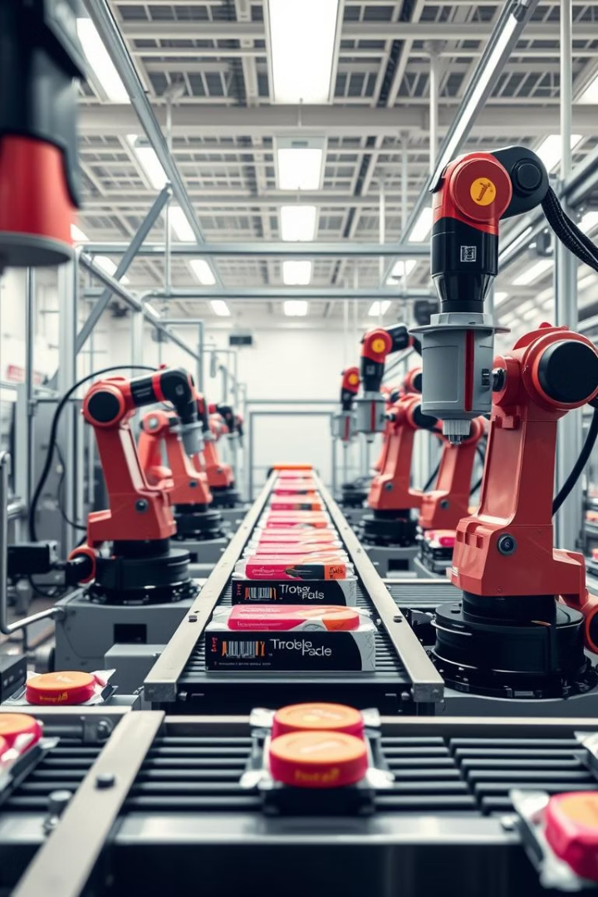

GenAI-Powered OEE Analysis Tool for Biscuit Packaging
Welcome to the NTT Data Internship case study presentation. My name is Smaran Rangarajan Bharadwaj from RV University, and today I will present a cutting-edge solution designed to enhance operational efficiency in biscuit packaging plants by leveraging Generative AI technology. This tool calculates and displays Original Equipment Effectiveness, or OEE, providing valuable insights for manufacturing optimization.
This presentation will cover problem definition, data characteristics, formulae, system design, and key outcomes with a focus on real-world application and scalability.
by Smaran Rangarajan Bharadwaj

Slide 2
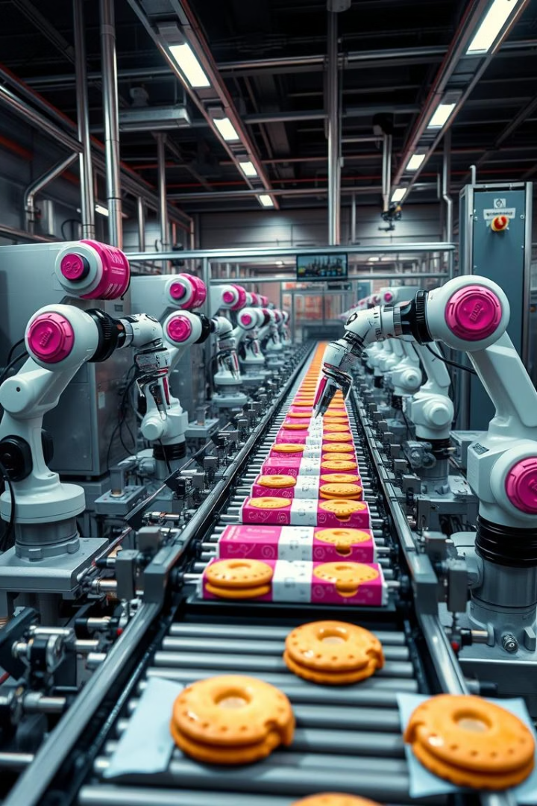
Problem Statement
Objective
Input & Filters
Develop an interactive Generative AI web application featuring a ChatGPT-style conversational interface that analyzes OEE of biscuit packaging devices.
The application processes IoT sensor data in .xlsx format from 2024 to 2025, allowing filtering by Device ID, Location, and Month for targeted analysis.
Output
OEE percentages are delivered through natural language responses, making complex manufacturing data accessible and actionable.

Slide 3
Data Format & Assumptions
Key Data Fields
Assumptions
Unit_ID: unique package identifier
Downtime definition thresholds based on time gaps exceeding twice the ideal cycle time
Timestamp: completion time per unit
Device_ID: machine identifier
Ideal_Cycle_Time is fixed per device, e.g., DEV_A1 = 1.8s, DEV_C3 = 2.0s
Location: plant or floor
Data presumed to be accurate and continuous within selected time frames
Production_Time: packaging duration
Ideal_Cycle_Time: target time per machine
Result: quality status ("Accepted" or "Rejected")

Slide 4
Formulae to Calculate the OEE
Availability (%)
Performance (%)
Downtime is detected via gaps in sensor timestamps exceeding twice the ideal cycle time.
Ratio of ideal cycle time times units produced over actual run time, reflecting production speed efficiency relative to the ideal.
availability = (actual_run_time / planned_time) * 100
performance = (ideal_cycle_time * total_units / total_production_time) * 100
Quality (%)
Overall Equipment Effectiveness
Percentage of accepted units out of total produced, measuring the yield of conforming products in the batch.
OEE combines all three metrics as Availability × Performance × Quality ÷ 10,000, providing a holistic operational efficiency metric.
quality = (accepted_units / total_units) * 100
oee = (availability * performance * quality) / 10000

Slide 5
Sample Dataset Rows
Index
Unit_ID
Timestamp
Device_ID
Location
Production_Time
Ideal_Cycle_Time
Result
4057
PKG2024_004058
2024-01-01 00:10:04
DEV_A1
Plant_3
1.58
1.8
Accepted
3641
PKG2024_003642
2024-01-01 01:37:56
DEV_A1
Plant_1
1.72
1.8
Accepted
80
PKG2024_000081
2024-01-01 03:24:32
DEV_C3
Plant_3
1.92
2.0
Accepted
4040
PKG2024_004041
2024-01-01 03:47:03
DEV_A1
Plant_3
1.83
1.8
Accepted
197
PKG2024_000198
2024-01-01 03:58:11
DEV_B2
Plant_1
1.97
2.2
Accepted

Slide 6
System Architecture: Data Flow and GenAI Integration
Data Ingestion
Agentic Framework
IoT sensors continuously feed production data into a centralized data lake storing .xlsx files for historical and real-time analysis.
QueryAgent extracts user parameters using AI-powered natural language understanding.
DataAgent manages data loading, validation, and filtering based on query.
OEEAgent performs calculations, generates reports, and validates metrics before output.

Slide 7
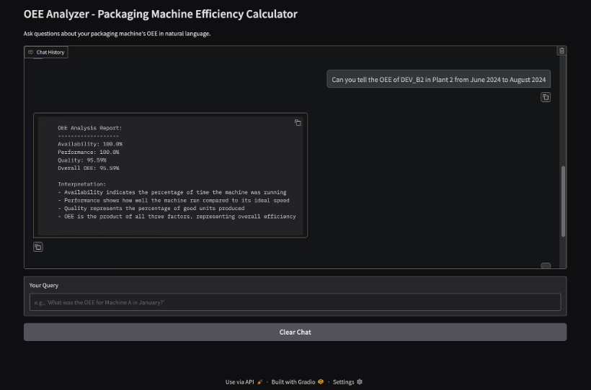
User Interface Preview:
The GenAI-powered web interface enables intuitive conversation with the system, where users ask about device efficiency by specifying parameters like device ID or time periods.
Responses include detailed OEE metrics presented in clear natural language, enhancing accessibility for operators and engineers alike.
Code Repository: https://github.com/smaranrb/oee_analyzer_biscuit_packaging.git

Slide 8
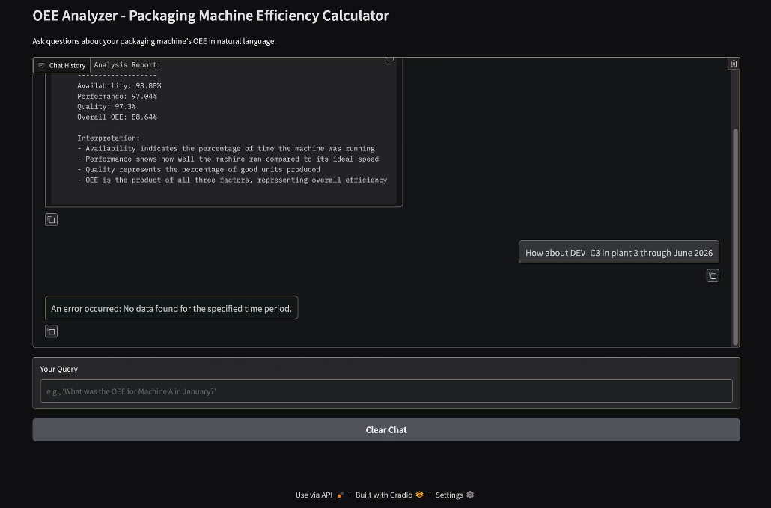
Missing inputs?
It can also handle missing query parameters if the user hasn't entered them in the prompt:

Slide 9



Technology Stack Powering GenAI OEE Tool
Python Ecosystem
Gradio UI
GenAI Models
Pandas and OpenPyXL for robust data processing and Excel file manipulation.
Enables dynamic conversational interface resembling ChatGPT for seamless user queries.
Mixtral-8x7B-Instruct and LLaMA 3 provide natural language understanding and agentic control.

Slide 10








Key Benefits of the Agentic Framework
Clear Responsibility
Modular Design
Each agent focuses on a defined domain: query processing, data management, or OEE calculation, reducing errors.
Allows independent development and easy maintenance of discrete agents handling specific tasks.
Independent Testing
Scalability
Enables thorough validation of each agent ensuring reliability and system robustness.
Supports growing data volumes and new device integrations with minimal system disruption.

Slide 11

Conclusion: GenAI Driving Efficiency and Innovation
This GenAI-powered OEE analysis tool exemplifies how AI can transform manufacturing by providing real-time actionable insights and predictive analytics.
It offers a scalable solution that enhances operational efficiency, reduces downtime, and supports continuous improvement. This tool equips manufacturing teams with the information needed to maintain a competitive advantage through innovation and data-driven decision-making.

